Slide 1


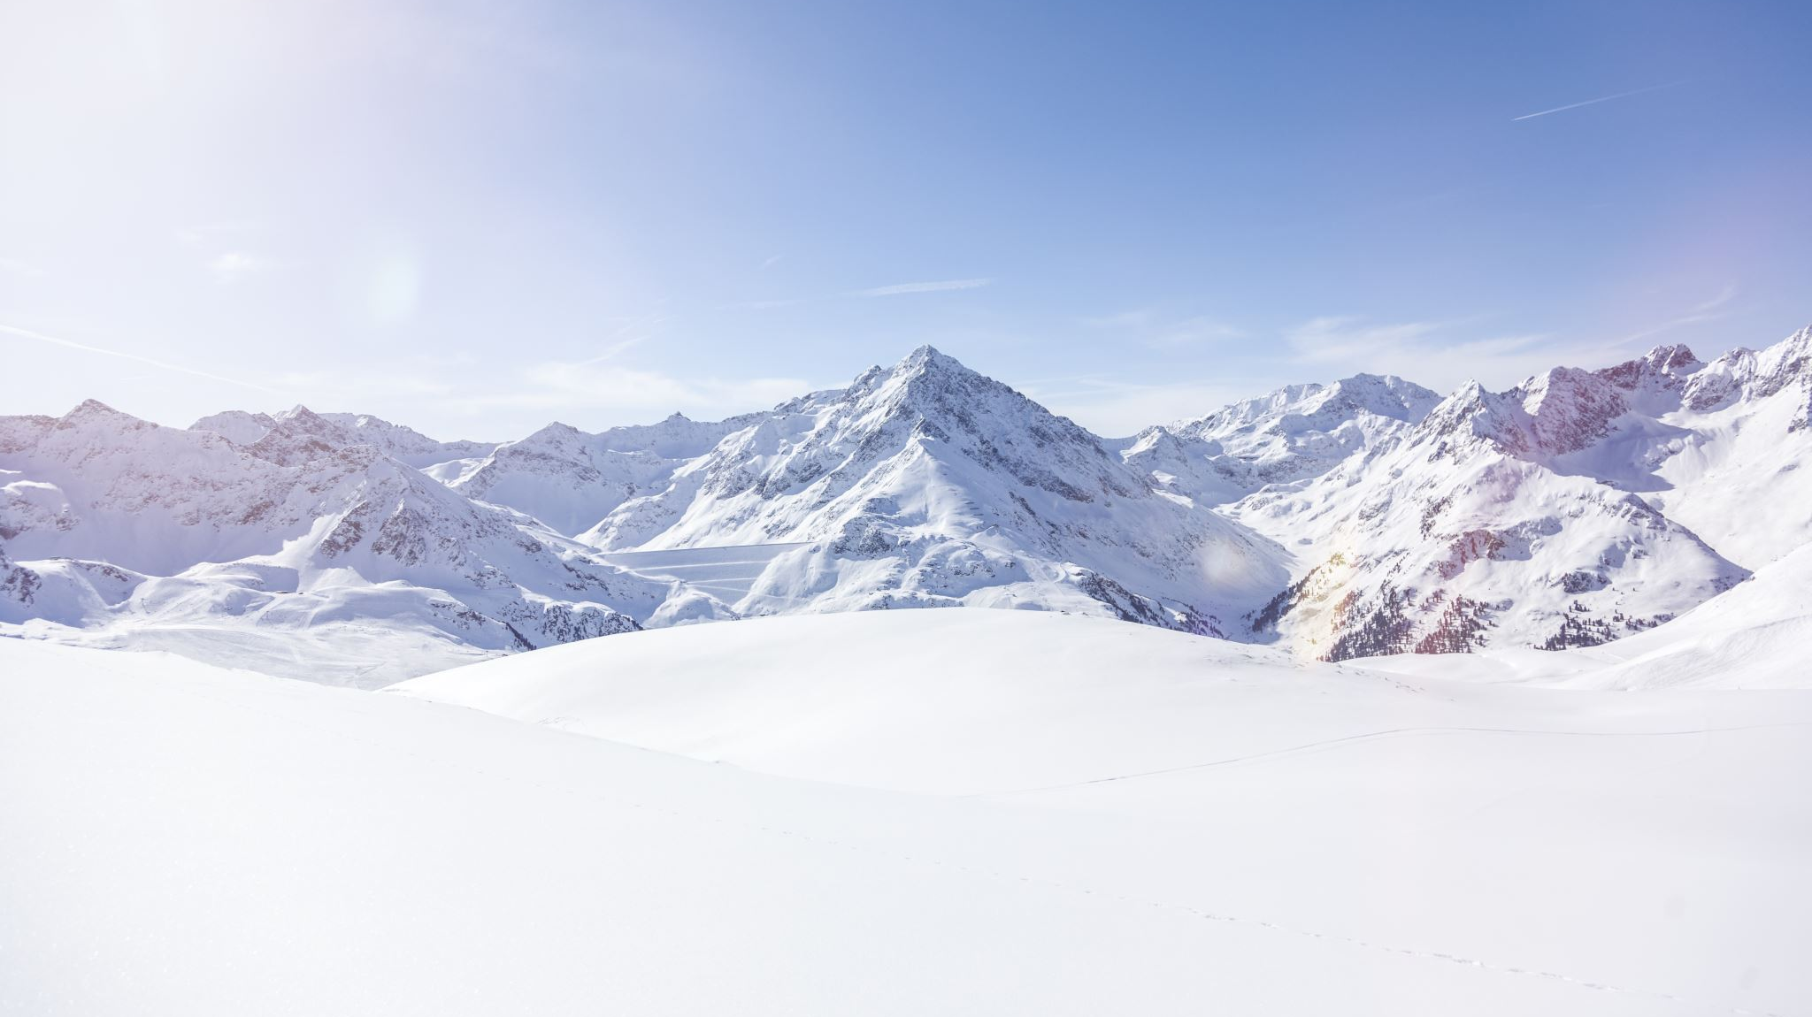
Big Mountain Ski Resort Guided Capstone
Data-Driven Ticket Pricing Strategy
By Svyatoslav Andriyishen

Slide 2
Big Mountain Ski Resort Overview
Big Mountain Ski Resort
Located in Montana
350,000 visitors per season
Average of 5 days per visitor
105 trails, 11 lifts, 2 T-bars, and 1 magic carpet for novices
What’s new at the resort?
New Ski Lift
increases the operational costs by $1.54 million this season
New Data Team
New Ticket Pricing Strategy
Old Strategy: charge a premium above the average price in the market segment
New Strategy: Model the price on the value of various facilities and other features of the resort by analyzing data on resorts in the market segment

Slide 3
Data-Driven Ticket Pricing
Use information on 330 resorts nationwide, considered to be in the same market segment
Add any other available data to enhance results
Model the price based on value of facilities and other features of the resort
Determine the best strategy for the upcoming season

Slide 4
Price increase recommendation
Big Mountain Resort modelled price is $95.87 (MAE $10.39)
Making our reasonable pricing range of $85.48 to $106.26
Actual current price is $81.00
It is safe to increase the price by at least $4 due to the current analysis of the market
At projected 350,000 visitors and average of 5 days of stay, we should expect to gain $7 million from this minimum price increase alone

Slide 5
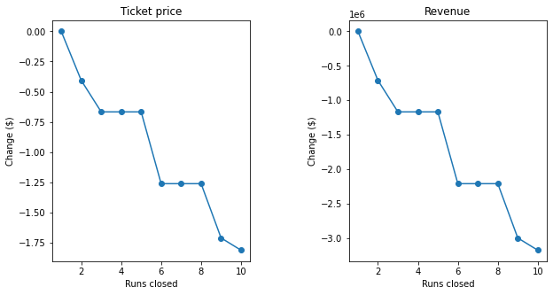
Four proposed scenarios
Permanently closing down up to 10 of the least used runs
(see figure)
The model says closing one run makes no difference. Closing 2 and 3 successively reduces support for ticket price and so revenue. If Big Mountain closes down 3 runs, it seems they may as well close down 4 or 5 as there's no further loss in ticket price. Increasing the closures down to 6 or more leads to a large drop.
Increase the vertical drop by adding a run to a point 150 feet lower down but requiring the installation of an additional chair lift to bring skiers back up, without additional snow making coverage
This scenario increases support for ticket price by $8.61
Over the season, this could be expected to amount to $15,065,471
Same as above, but adding 2 acres of snow making cover
This scenario increases support for ticket price by $9.90
Over the season, this could be expected to amount to $17,322,717
Increase the longest run by 0.2 mile to boast 3.5 miles length, requiring an additional snow making coverage of 4 acres
Makes no difference in the random forest model that was ultimately chosen
Leads to higher operational expenditures
There are four proposed scenarios that Big Mountain Resort has been considering for the upcoming season.
On the right is a summary of those scenarios color-coded by recommendation:
Red = No
Yellow = Conditional
Green = Full speed ahead!

Slide 6
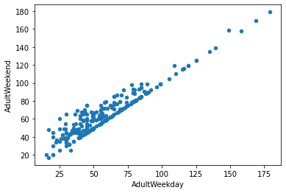
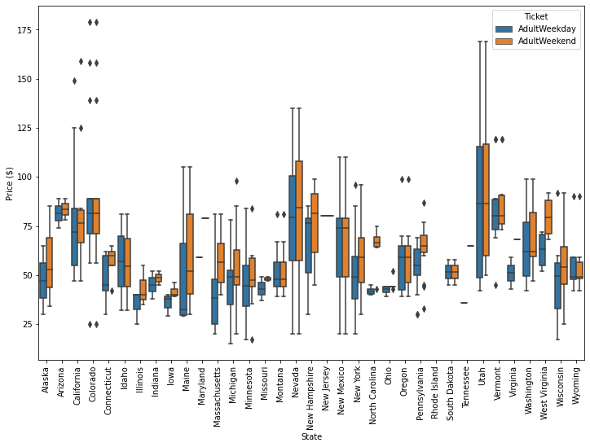
Which price to model?
The data contained two price variables: Weekend and Weekday
Weekend price was chosen, because:
All resorts in Montana have the same price regardless of day of week
There isn’t a significant difference in weekend and weekday prices in most cases
Weekday price had more missing values

Slide 7
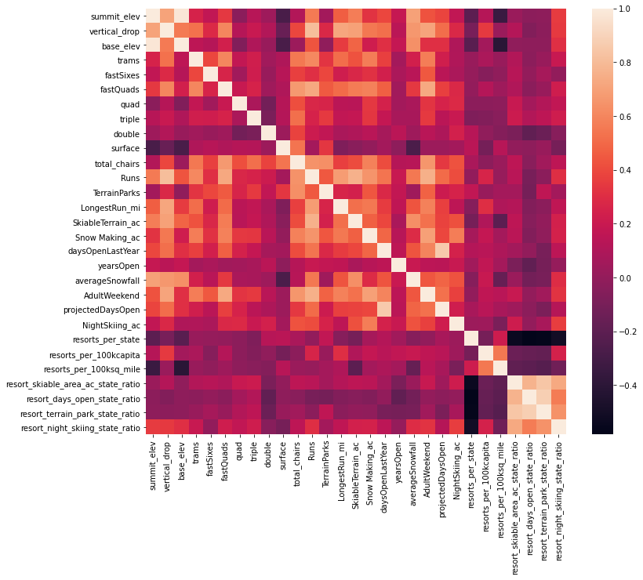
Examining features
A heatmap of correlations between features helps point us to the most important features discussed in a future slide
It also shows that some features are too correlated and will have to be dropped

Slide 8
Evaluating models
Three models evaluated:
Means Model
Takes the average of the market segment (current business model)
Linear Model
Performed well, but random forest performed better
Did not perform well on test data
Random Forest
Performed best on training and testing data and during cross-validation
MAE of 9.64, with standard deviation of 1.35 on training data
MAE of 9.54 on testing data
There’s room for improvement

Slide 9
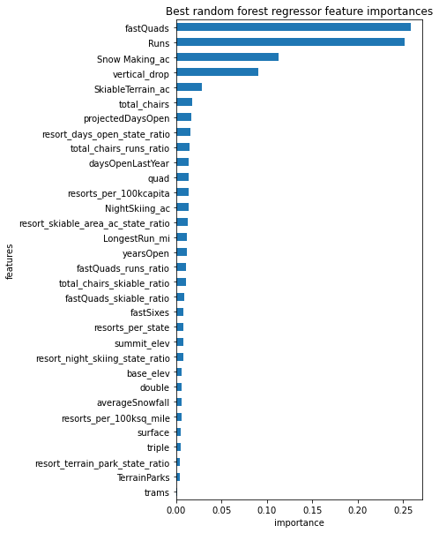
Determining most important features
Model performance was improved by limiting features of importance
Preventing over-fitting phenomenon
Most important features in modeling were:
vertical_drop
Snow Making_ac
total_chairs
fastQuads
Runs
LongestRun_mi
trams
SkiableTerrain_ac
The top four features in random forest model (final model, graph on the right) are common with the linear model:
fastQuads
Runs
Snow Making_ac
vertical_drop

Slide 10
Summary and Conclusion
Recommendations to implement NOW:
Increase the price by at least $4
Add a run and lift to increase vertical drop by 150 feet to allow adding $8.61 to the ticket price
Conditionally look into increase snow-making area coverage and/or closing least-used runs as per the data presented
Continue improving the model
MAE is still high and the model has uncertainty
Recommend additional operational costs, visitor, and marketing data to be obtained and analyzed to improve the model as discussed in attached report

